Slide 1
Design Reports: Purpose, Audience, Content and why they matter to you
MENG 4920
Computer Aided Design
Winter 2019 / McCall
Notes:
We know that about half of your time as an engineer will be spent in communicating about your designs.
You’ll be sending emails to teammates and memos to bosses. You’ll be making presentations to your management team and then to customers.
In this class, we are focusing on creating the design reports you’ll be writing for your internal engineering management boss / team.
These are the reports that help move your design from concept to customer.
All engineering organizations produce design reports. They may differ slightly in format, but the purpose and content are the same.
Let’s take a look at how design projects and reports help your organization.

Slide 2
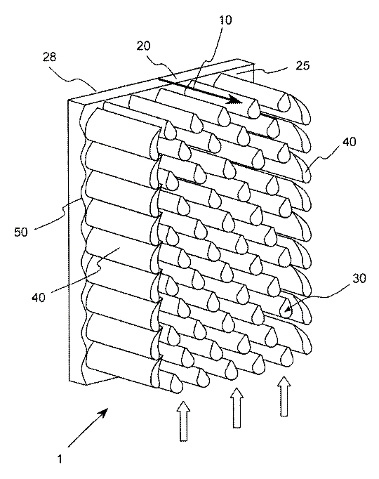
Purpose: Design Projects
Develop / refine products and systems for the company that will:
Increase profits
Attract new customers
Retain current customers
Expand market
Build reputation for innovation
Interest investors
Other (ex., help society, environment)
Notes:
Companies want to stay in business. To do this, they need to make money. They do this by bringing new or improve products and systems to market.
Your job as an engineer is to identify needs and markets, and develop products that support them.
Remember back to ENGR 1020, when you were tasked with making a multi-tool for a specific audience? You found out that 4.5 million Americans go camping every year, and decided to build a multi-tool with seven features to support a camper.
Then, in ENGR 1080, you learned more about market research and customer demand. You worked in a team to bring a product to the point where it could be presented to an investor.
MENG 4290 gives you the chance to be part of an R&D team at a manufacturing company. You are an employee whose task is to design products and help your management team see how and why they are worth bringing into production.

Slide 3
Purpose: Design Reports
Present information for decision making:
Document and author must be credible
Format, tone, language and data are important
Clear idea of design problem and how your design fits into the continuum of thought (secondary research)
Well-described thought process for design approach and changes in the design iterations (primary research)
Format that shows the reader that you know and respect engineering conventions
Notes:
Design reports have a function in organizations.
Every product has a life span, running from inception to retirement.
The design report comes towards the beginning of the product’s life. It shows why the product idea is worth bringing into production.
Other documents detail the life cycle, including quality reports, patent applications, customer reviews, and progress reports.

Slide 4
Audience
Executive / Technically Proficient Reader
Typically your supervisor
Decision maker about which products advance into production
Looking for
Well-researched design with cited references
Data that supports the design claims
Data shown in graphics where possible
Well-reasoned argument that s/he can support and share with superiors
Notes:
Try to have a picture of your audience in your mind as you develop your report.
For this class, we are using Dr. P. as our audience. She is the head of R&D for Plantenberg Enterprises, Inc., so she is an executive, plus she knows engineering.
When you write for Dr. P., consider the amount of detail and language to use. Consider the amount and type of evidence to include.

Slide 5
Content
Introduction
Design problem, research, limitations
Results and Discussion (Body)
Description of Design 1 with graphic and data
Why did you take this approach? What tool(s) did you use?
Description of Design 2 with graphic and data
What changes did you make to Design 1? Why?
Etc. until you reach Final Design
FEA, physical test results (proof of your claims)
Assumptions
Conclusion and Recommendations
Does your Final Design meet the specifications?
What needs to happen next?
Notes:
The design report tells the story – the technical story – of your design and how you went from a sketch on a napkin to a final design ready for prototyping.
NOTE: This slide is just the report text. The report also includes a title page, Executive Summary, T of C, References, and Appendices.

Slide 6
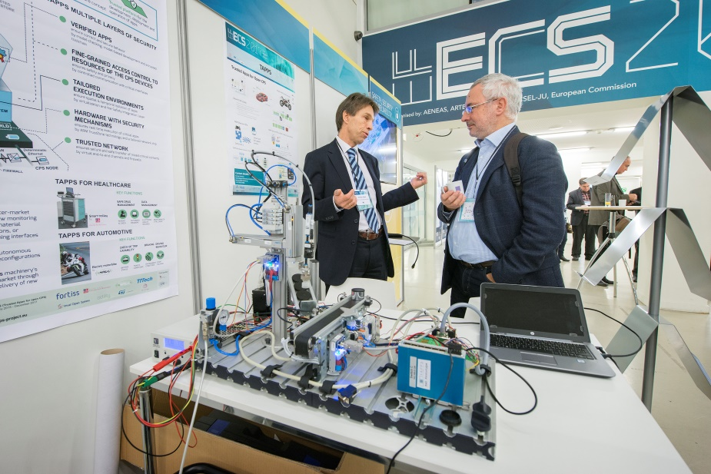
Tone
The EFECS exhibition contains: running R&D&I projects, new project ideas, affiliated organisations, organisers of the event, face-to-face networking area, and a speakers corner. Courtesy of efecs.eu
Formal Tone
Third person
Ex., “the FEA analysis showed” vs. “We learned…” or “You should know that…”
Complete sentences
Adherence to template format (include all required sections in the order they appear)
No opinions
Ex., no “I think” / “I believe” / “I feel”
Only evidence-based claims
Use of ASME format for in-text citations and References
No colloquialisms or contractions
Ex., no “a lot” or “take it to the next level” or “couldn’t”
Notes:
You and your document must show respect since you are writing for an executive audience, one who is technically proficient and has decision-making responsibilities.
One of the ways to show respect is to use the conventions that other engineers use (language, design reports, ASME format). Another example of this is wearing a suit to a job interview.
Another way is to use a formal tone.

Slide 7
References
American Society of Mechanical Engineers (ASME)
Examples and details at:
BlackBoard site
http://www.asme.org/shop/proceedings/conference-publications/references
University of Missouri at https://libraryguides.missouri.edu/mae/asmecitation
Sample:
[1] Lastname, F. M., Lastname, F. M. and Lastname, F. M., Year of Publication. Title of Book. Publisher, City, ST of publication.
[1] Watt, J. H. and van der Berg, S.A., 1995, Research Methods for Communication Science, Allyn and Bacon, Boston, MA.
Notes:
All in-text references and those listed at the end in References need to use ASME format.
If you are unfamiliar with ASME citation format, check out these resources.
Notice that, unlike MLA and APA, ASME does not list authors alphabetically. Instead, they are listed by number. Ex., [1] is the first reference that appears in the text. [2] is the second reference, and so on.

Slide 8
template
Available on:
Blackboard course site
http://www.engineeringessentials.com/writing/
Notes:
NOTE: Make sure you select the template labeled MENG 4920.
Templates are designed to save you time, make sure all the right information is included, and allow you to focus on content vs. formatting.
An extra benefit is that the template gives your report a professional appearance, helping make your document (and you) credible to your audience.

Slide 9
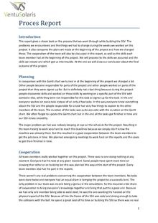
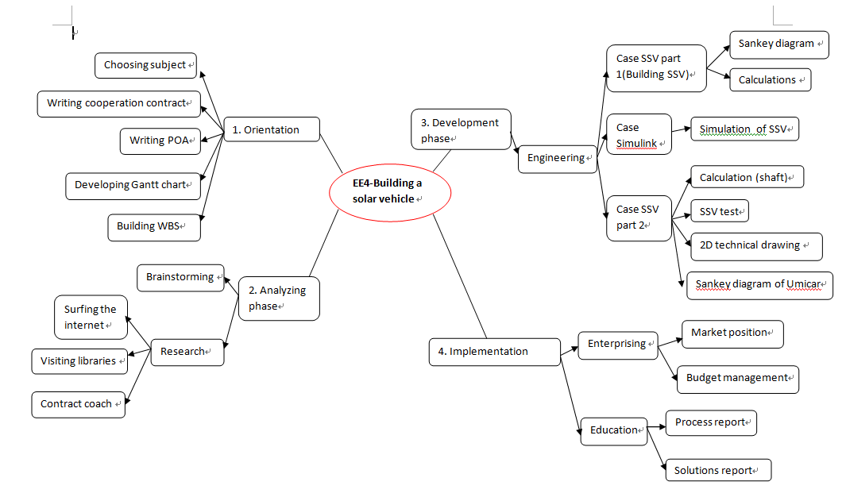
Looking Ahead
Notes:
NOTE: Students don’t always get to see all the documents that support their design projects.
In MENG 4920, you see the worksheets that capture your data and the design report.
Here you see a photo of a solar vehicle prototype, a page from its report, and a decision tree used to map the project steps.

Slide 10
Q & A
The start-up area at the Embedded World Conference Courtesy of www.embedded-world.de.

